Slide 1

Optimizing Neural Network Weights
Using Particle Swarm Optimization (PSO)
Kevin Shah 231070060 (Computer Engineering)
Viraj Vora 231070078 (Computer Engineering)

Slide 2


The Optimization Challenge
Conventional gradient-based methods for training neural networks face limitations, such as becoming trapped in local minima.
Gradient-Based Limitations
Need for Alternatives
Backpropagation is efficient but susceptible to local minima in complex error landscapes.
Exploring gradient-free strategies like Particle Swarm Optimization (PSO) for global search.

Slide 3



Foundational Concept: Feedforward Neural Networks (FNNs)
Information flows unidirectionally through layers of interconnected neurons.
Core Components
Layered Architecture
Loss Function
Neurons compute weighted sum of inputs, plus bias, passed through a non-linear activation function.
Input, hidden (feature extraction), and output layers.
Quantifies error; objective is to minimize loss by tuning weights and biases.
Weights and biases are the tunable parameters the network "learns."

Slide 4

Foundational Concept: Particle Swarm Optimization (PSO)
A population-based, stochastic metaheuristic inspired by social behavior (flocks/schools).
Swarm Mechanics
A swarm of particles, each representing a potential solution (position) with a movement vector (velocity).
Guiding Intelligence
Movement is guided by Personal Best (pbest) and Global Best (gbest) positions.
Gradient-Free
Searches large spaces without requiring gradient information.

Slide 5

PSO: The Update Equations
Particles balance inertia, cognitive component (pbest), and social component (gbest) to update their movement.
Velocity Update: Balances current velocity, personal best, and global best.
Position Update: New position is current position plus new velocity.
χ is the constriction factor; c1, c2 are acceleration coefficients; r1, r2 are random numbers.

Slide 6

Synthesizing PSO and Neural Networks
Reframing network training as a global optimization problem for PSO.
Encoding the Network
Loss as Fitness
All weights and biases are flattened into a single vector, which becomes the particle's position.
The network's loss function (e.g., MSE) serves as the PSO's fitness function. Lower loss = better fitness.
Optimization Loop
Swarm is initialized, fitness evaluated, and particles iteratively update position/velocity until termination criterion is met.

Slide 7
PSO vs. Gradient Descent: Comparison
Two fundamentally different optimization philosophies with distinct trade-offs.
Method Class
PSO
Traditional
Derivative
None required
Requires differentiable functions
Local Minima
Less likely to be trapped
Prone to converging to nearest minimum
Computational Cost
High (many forward passes per iteration)
Lower (one forward/backward pass)
Scalability
Poor (Curse of Dimensionality)
Excellent (Standard for deep networks)

Slide 8


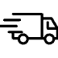
Inherent Challenges of PSO Training
Limitations prevent PSO from being the standard for large-scale deep learning.
Curse of Dimensionality
Premature Convergence
Performance degrades significantly with increasing parameters (dimensions). Infeasible for modern networks with millions of weights.
Swarm may converge too quickly on a suboptimal gbest, losing diversity and exploration capability.

Slide 9








Conclusion: Evolving Role of PSO
PSO is not a replacement for gradient descent, but a powerful complement.
Global Search
Better Initialization
Navigates complex, multimodal loss landscapes.
Provides excellent starting points for gradient methods.
Robust Frameworks
Architecture Tuning
Contributes to more robust and powerful optimization systems.
Excels in optimizing non-differentiable network structures.
PSO's future is in hybrid and neuroevolutionary models.

Slide 10
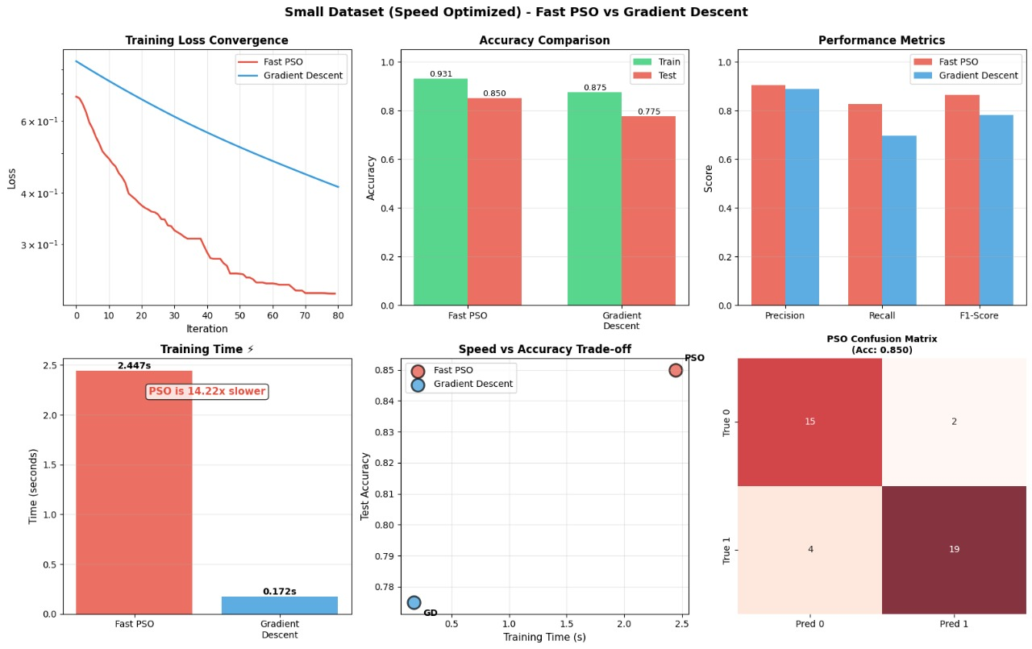

Results(small dataset)

Slide 11
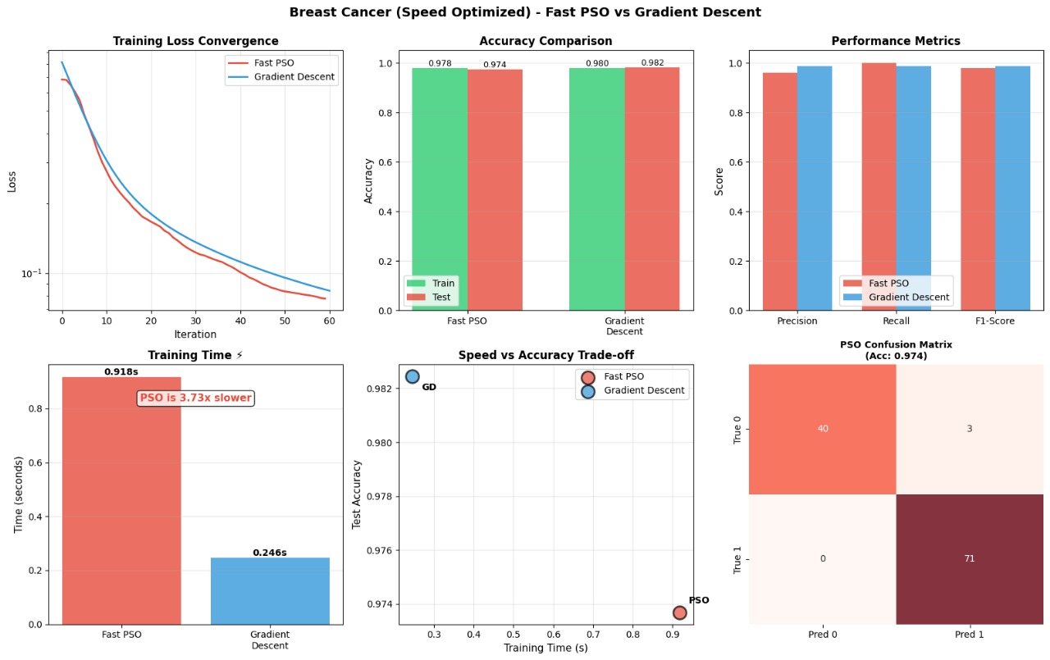
Results(large dataset)

